Slide 1
AIR QUALITY INDEX ANALYSIS
(AQI)
SIDDHI JADHAV 23070243047
SHAHEEN KHAN 23070243045

Slide 2

TABLE OF CONTENTS
OBJECTIVE
1
4
STATISTICAL ANALYSIS AND MODEL SELECTION
UNDERSTANDING AQI
2
5
RESULTS
ABOUT DATA
3
6
CONCLUSION

Slide 3

OBJECTIVE
1

Slide 4


Objective and purpose
Objective:
Predict the AQI of cities in India based on given data, with AQI values ranging from 1 to 5.
Purpose:
Use machine learning algorithms to classify cities as either "risk-averse" or "non-risk-averse" based on AQI levels.
Help in taking controlled actions to stabilize AQI in risk-averse areas.
Visualize these classifications using ArcGIS, displaying risk-averse zones within cities for a clear, actionable geographic perspective.

Slide 5

Understanding AQI AND DATA
A BRIEF DESCRIPTION ABOUT DATA AND EFFECTS OF AQI

Slide 6
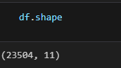
UNDERSTANDING AQI AND DATA
DATA
We gathered the information from the Indian government database, which includes the concentrations of pollutants at different locations around India. We have created a model that can estimate India's air quality in any location by predicting the air quality index of each available data point in the dataset.
CENTRAL BOARD OF POLLUTION CONTROL
The Air Quality Index (AQI) is
standardized scale used to measure and
report air quality levels in a specific
location. It assesses the concentration of
common air pollutants and translates
these values into a simple number and
color-coded scale, making it easy for the
public to understand the air quality and
its potential health effects.

Slide 7

Air particulate matter
PM10 AND PM2.5
OZONE O₃
Nitrogen Dioxide (NO₂)
particulate matter pm10 and pm2.5. Small particles that can penetrate the lungs and bloodstream, causing respiratory and cardiovascular issues.
A pollutant at ground level that can cause breathing problems and aggravate lung diseases.
Primarily from vehicles and industrial activities, it can irritate airways and worsen asthma

Slide 8
Air particulate matter
Carbon Monoxide (CO)
Sulfur Dioxide (SO₂)
NH₃ (Ammonia)
Released by industrial processes, it can affect breathing and aggravate existing heart and lung diseases.
is a colorless gas with a pungent odor, composed of nitrogen and hydrogen atoms. It occurs both naturally and as a result of human activity.
Produced by burning fossil fuels, it
can prevent oxygen from reaching
organs and tissues.

Slide 9
SYSTEM ARCHIRECTURE

Slide 10
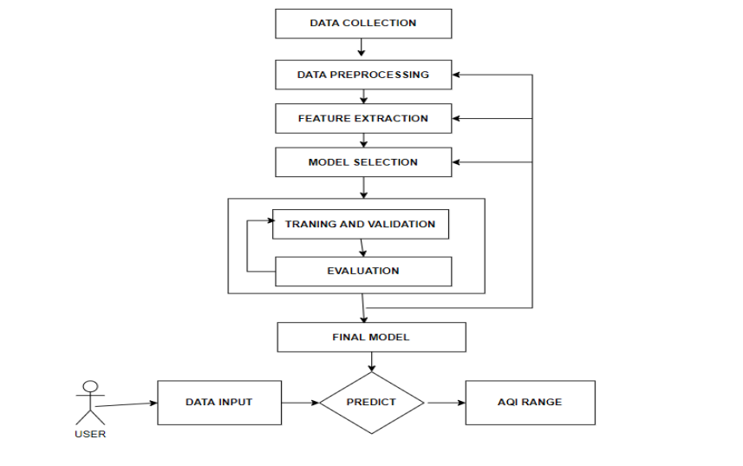

Slide 11

STATISTICAL ANALYSIS AND MODEL SELECTION
USING MACHINE LEARNING MODELS TO PREDICT THE AQI

Slide 12
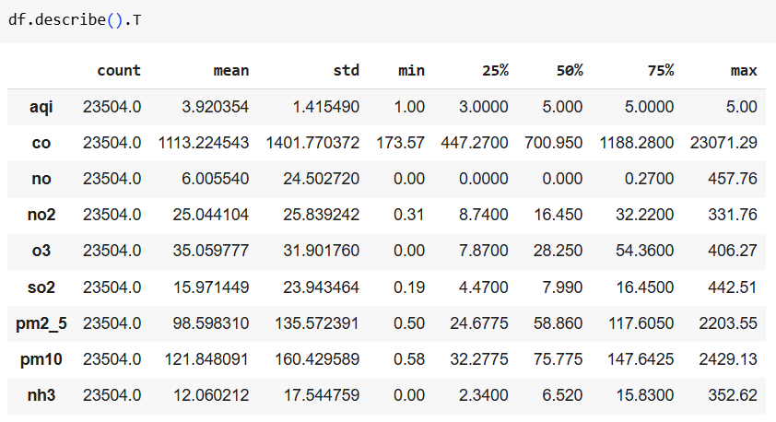
Statistics

Slide 13
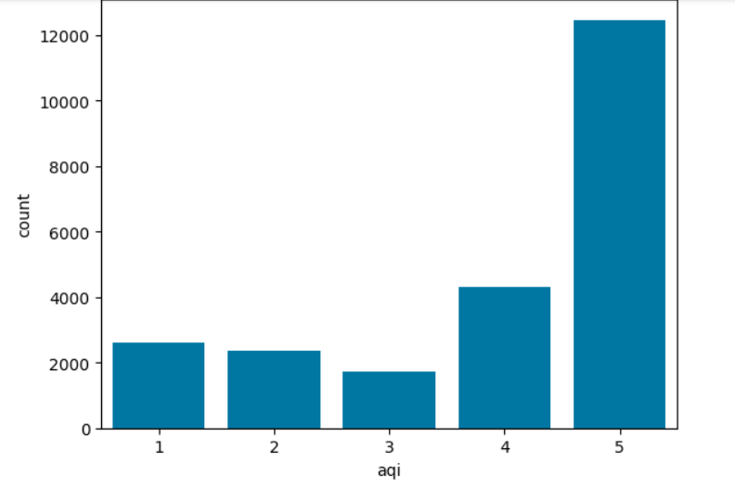
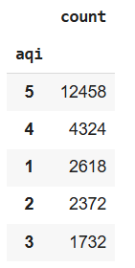
EXPLORATORY DATA ANALYSIS

Slide 14
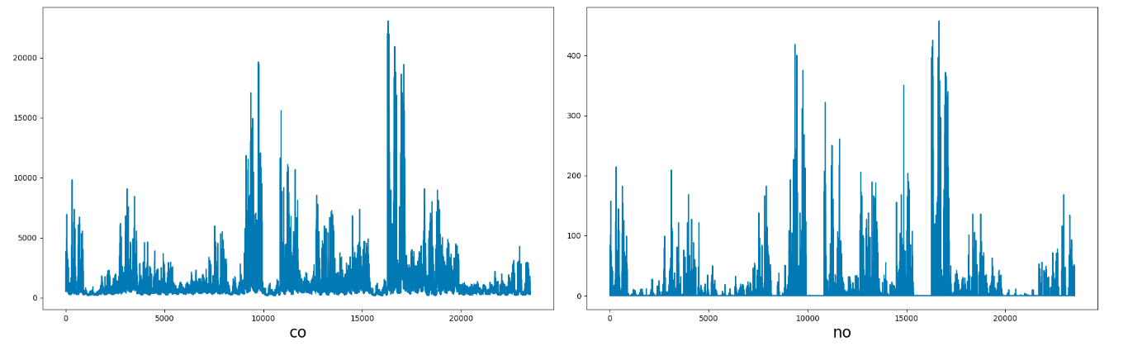
EXPLORATORY DATA ANALYSIS

Slide 15
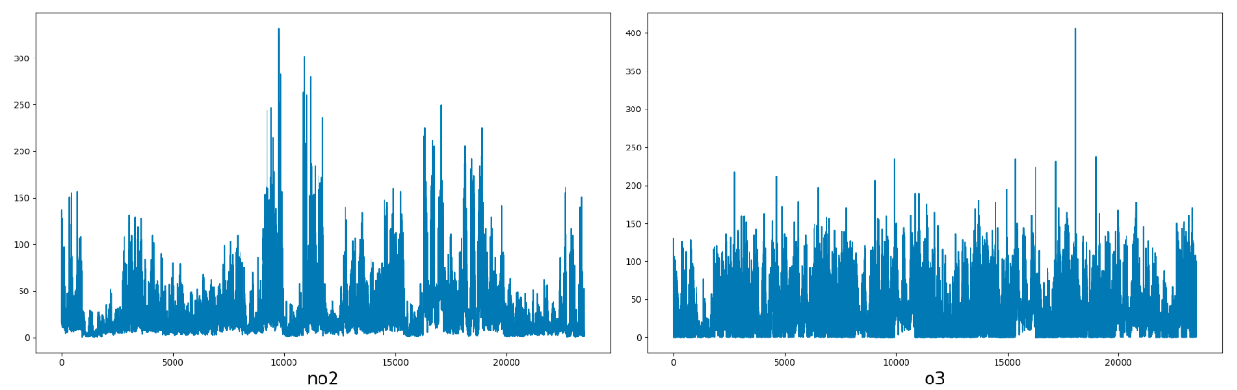
EXPLORATORY DATA ANALYSIS

Slide 16
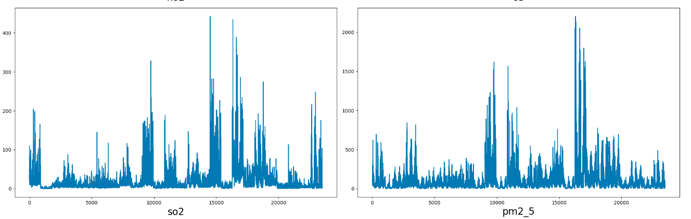
EXPLORATORY DATA ANALYSIS

Slide 17
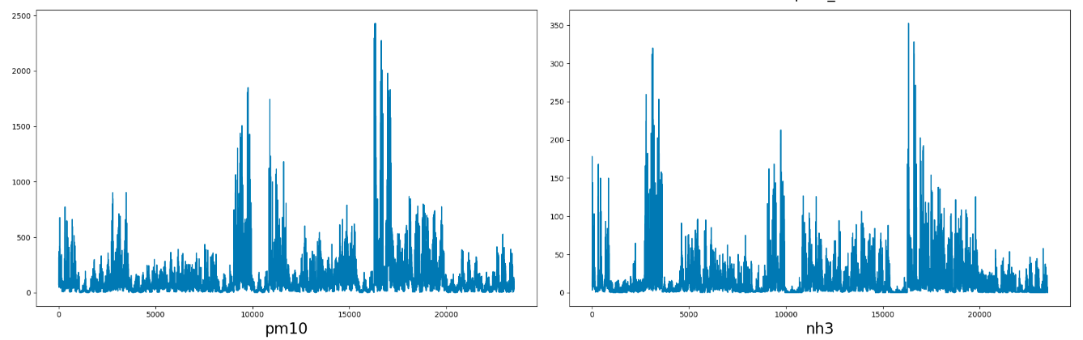
EXPLORATORY DATA ANALYSIS

Slide 18
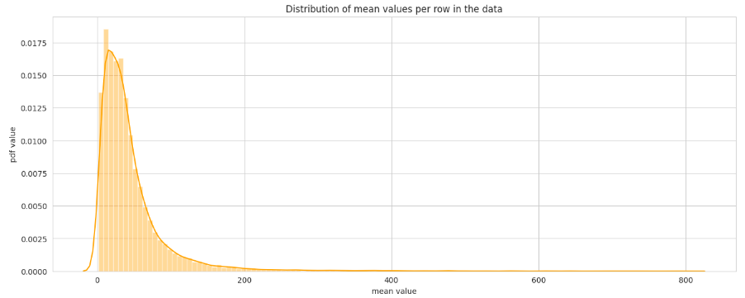
DISTRIBUTION OF MEAN VALUES PER ROW IN DATA

Slide 19
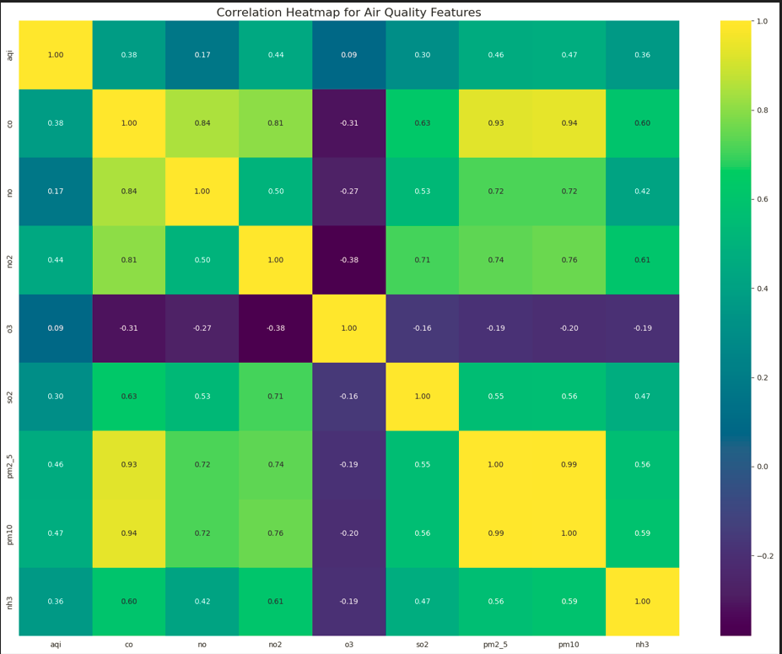
CORRELATION

Slide 20
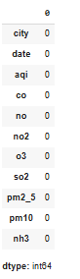
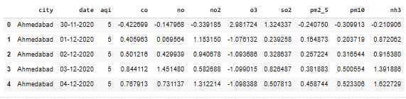
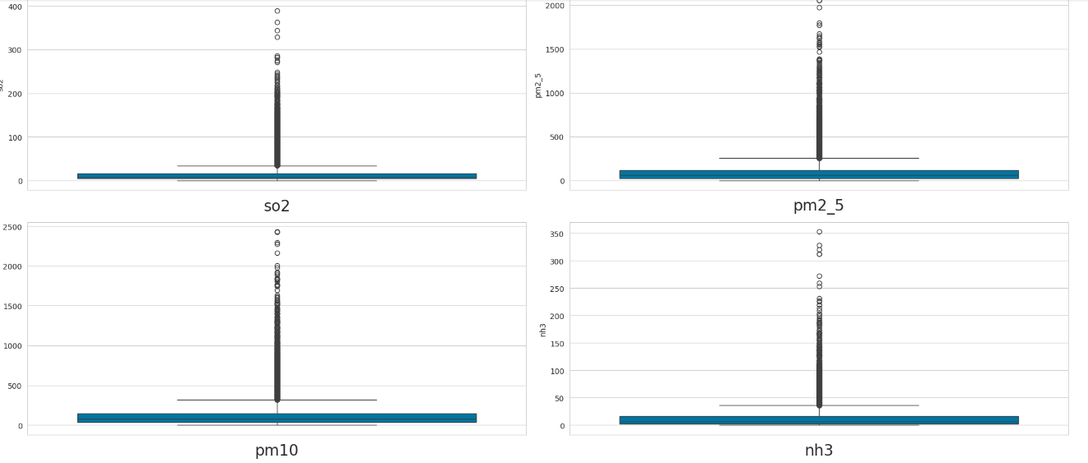
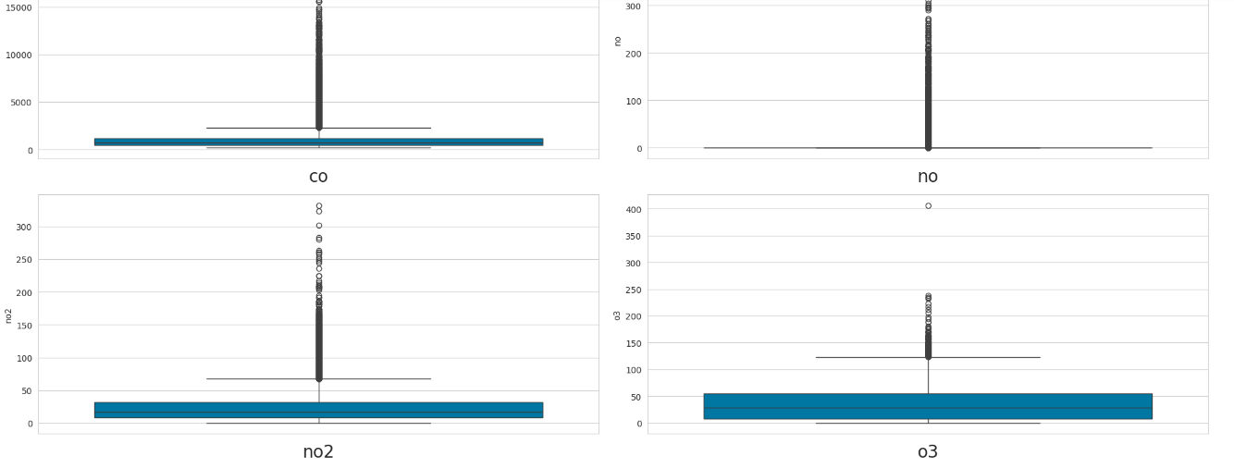
FEATURE ENGINEERING AND SCALING

Slide 21
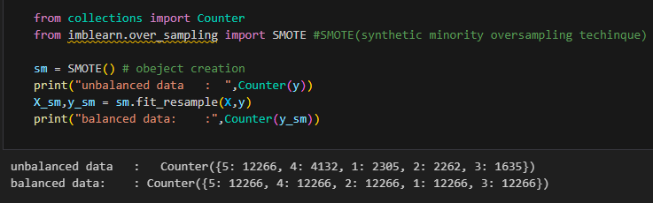
SMOTE ANALYSIS
to address class imbalance in the dataset. SMOTE generates synthetic samples for the minority class by interpolating between existing instances, effectively increasing its representation without merely duplicating samples. This approach helps the model to learn more effectively by providing a balanced view of both classes, improving overall classification performance and reducing bias toward the majority class. By applying SMOTE to the preprocessed dataset, we aimed to achieve better prediction accuracy and generalization across imbalanced data.

Slide 22


2
Model selection

Slide 23
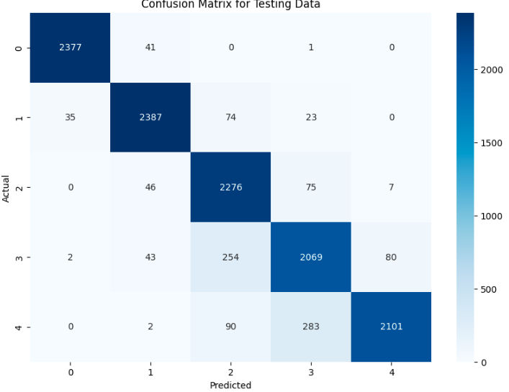
KNN
The KNN algorithm classifies new data points based on the 'k' closest examples in the training set. By calculating distances (typically using Euclidean distance), KNN finds similar cases, making it a memory-based algorithm. The model is trained using the preprocessed dataset, but it does not explicitly learn an internal model. Instead, it stores all data points and compares them during the prediction phase, categorizing a point based on the majority class of its nearest neighbors.

Slide 24
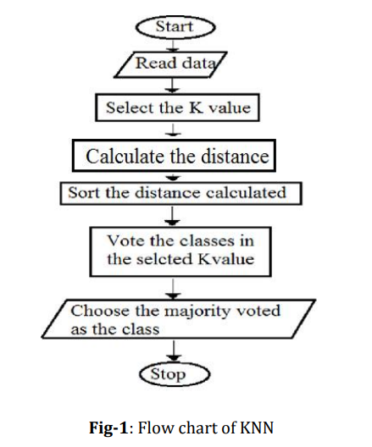

Slide 25
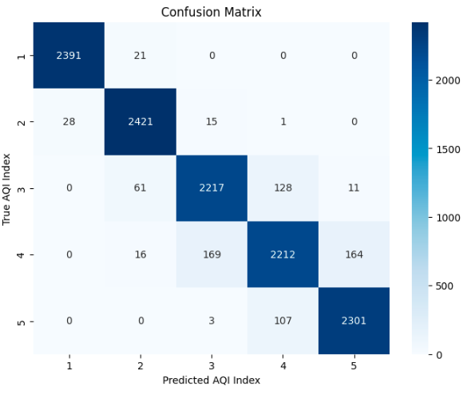
RANDOM FOREST
Random Forest is an ensemble learning method that constructs multiple decision trees and combines their predictions. In air quality prediction, Random Forest can be used to predict the AQI for a new combination of environmental factors by combining the predictions of multiple decision trees. The model is trained using the preprocessed dataset. The training data is used to construct multiple decision trees using different subsets of the features and the data points.

Slide 26
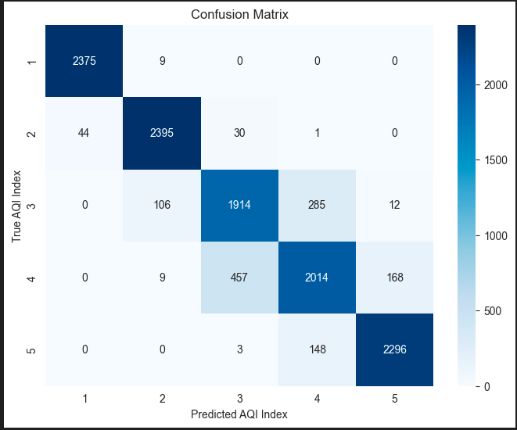
XGB CLASSIFIER
The XGBoost Classifier, short for Extreme Gradient Boosting, is an ensemble technique that builds a sequence of decision trees. Each new tree attempts to correct the errors of the previous ones by emphasizing incorrectly classified data points. This model uses gradient descent to minimize the loss function, making it highly efficient and often more accurate than traditional boosting methods. The model is trained using the preprocessed dataset, where each tree iteration progressively improves the overall prediction accuracy.

Slide 27
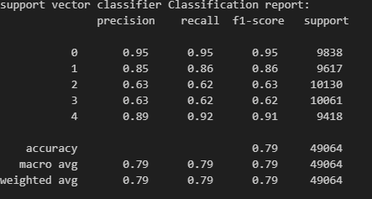
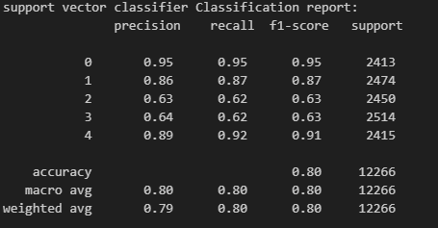
SUPPORT VECTOR CLASSIFIER
TRAINING
SVC chooses the extreme points/vectors that help in creating the hyperplane. These extreme cases are called support vectors, and hence algorithm is termed a Support Vector Machine. The model is trained using the preprocessed dataset. The training data is used to construct multiple decision trees using different subsets of the features and the data points.
TESTING

Slide 28
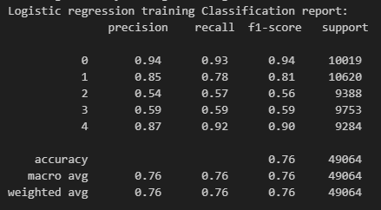
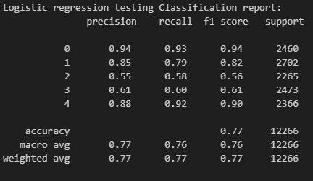
LOGISTIC REGRESSION
Logistic Regression is a statistical model that classifies data by estimating the probability that a given input belongs to a certain category. It applies the logistic function to ensure that the output probabilities are bounded between 0 and 1. This model learns weights for each feature during training on the preprocessed dataset, optimizing them to minimize the error in predictions by using a cost function. It is particularly suited for binary classification tasks, where it assigns data points to one of two classes.

Slide 29
RESULT
MODEL | Training Accuracy | Testing Accuracy
ANN | 85% | 86%
Logistics Regression | 75% | 76%
Random Forest | 100% | 95%
XGB Classifier | 94% | 85%
Support Vector Classifier | 51% | 51%
KNN | 94% | 91%

Slide 30
CONCLUSION
Finally, machine learning models for air quality prediction could be integrated with traditional air quality monitoring techniques to provide a more comprehensive understanding of air pollution.
This could involve combining machine learning models with ground-based air quality monitoring stations or integrating them with mobile air quality monitoring platforms, such as drones or vehicles.
Overall, air quality prediction using machine learning 6 has shown promising results, and further research could lead to improved prediction accuracy and more effective strategies for mitigating the health and environmental effects of air pollution

Slide 31
FUTURE ENHANCEMENT
The Future enhancements deals with collecting data from the IOT Device which is built to get the required pollutants of our location. With the help of other Advance machine learning algorithms, the project can predict the future quality of air like for next hours, days and week

Slide 32
GEOSPATIAL ANALYSIS

Slide 33
THANK YOU

